Slide 1

Chemical Bonding

Slide 2
Ionic and Covalent Bonding
Ionic Bonds
Describing Ionic Bonds
Electron Configurations of Ions
Ionic Radii
Covalent Bonds
Describing Covalent Bonds
Polar Covalent Bonds; Electronegativity
Writing Lewis Electron-Dot Formulas
Delocalized Bonding: Resonance
Exceptions to the Octet Rule
Formal Charge and Lewis Formulas
Bond Length and Bond Order
Bond Energy

Slide 3
Concept of Chemical bonding
More than fifty millions of known chemical compounds that make up our physical world
composed almost entirely of compounds and mixtures of compounds: Rocks, coal, soil, petroleum, trees, and human bodies are all complex mixtures of chemical compounds in which different kinds of atoms are bound together.
Chemical bonding is nothing but a strong attractive force that exist between certain atoms in a substance. The chemical bond is a effect that causes certain atoms to join together to form enduring structure that have unique physical and chemical properties
Where these type of attractive force is come from??
Result of Chemical boding is the Molecule
Molecules are the particles that result when atom become joined together in some way, but more precisely
A molecule is am aggregate of atoms that possess distinctive observable properties

Slide 4
1926: the Schrödinger equation
Before 1926: Classical description of the chemical bond
Chemists developed a powerful suite of concepts and tools
Covalent bonds
Ionic bonds
Polar covalent bonds
Electronegativity,
Lewis electron dot diagrams and
Valence shell electron-pair repulsion (VSEPR) theory
Quantum concept of Chemical bonding covalent boding
Valence bond theory
Molecular orbital theory

Slide 5
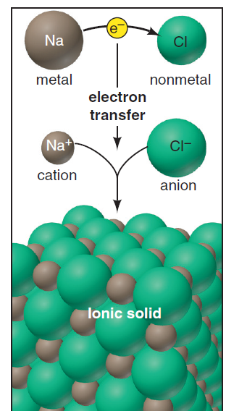
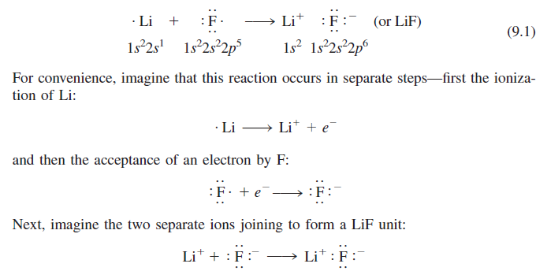
Ionic bonding
Salt dissolved in water or molten salt permits the flow of electricity

Slide 6
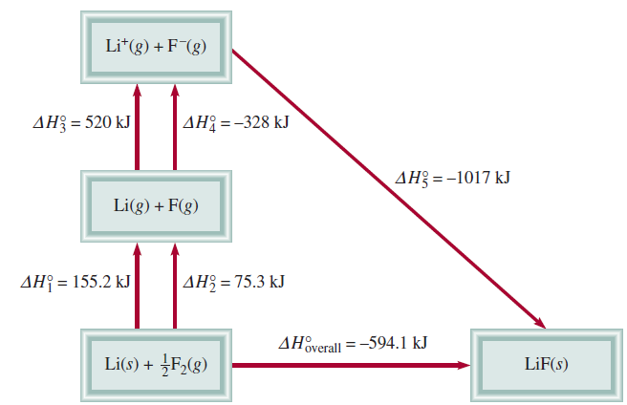
Energy involved in ionic bonding
Ionization energy
Electron affinity
How do we predict the stability of ionic compounds??
Lattice energy
The energy required to completely separate one mole of solid ionic compound into gaseous state
Born-Haber Cycle

Slide 7
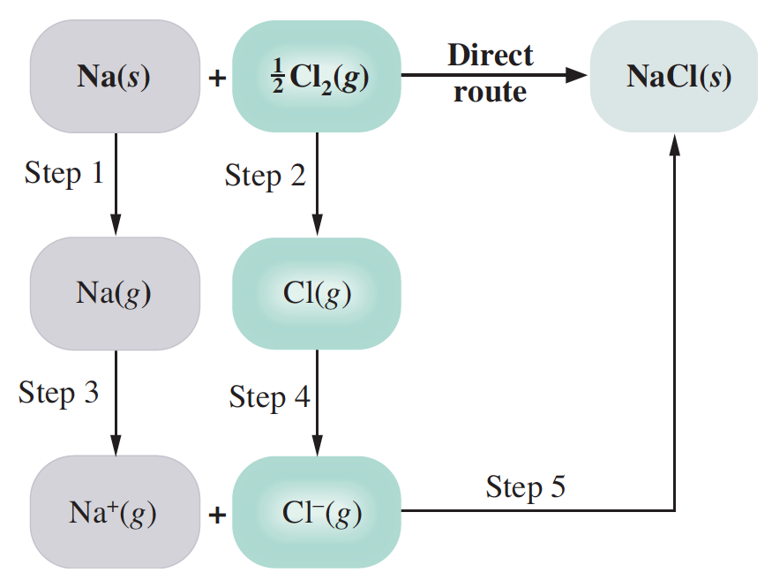
Lattice Energies from the Born–Haber Cycle
The lattice energy is the change in energy that occurs when an ionic solid is separated into isolated ions in the gas phase. For sodium chloride, the process is
1. Sublimation of sodium: 108 kJ/mole
2. Dissociation of chlorine: 120 kJ/mole
3. Ionization of sodium: 496 kJ/mole
4. Formation of Cl– ion: – 349 kJ/mole
5. Formation of NaCl(s) from ions: negative of the lattice energy. If we let U be the lattice energy, the enthalpy change for Step 5 is –U.

Slide 8
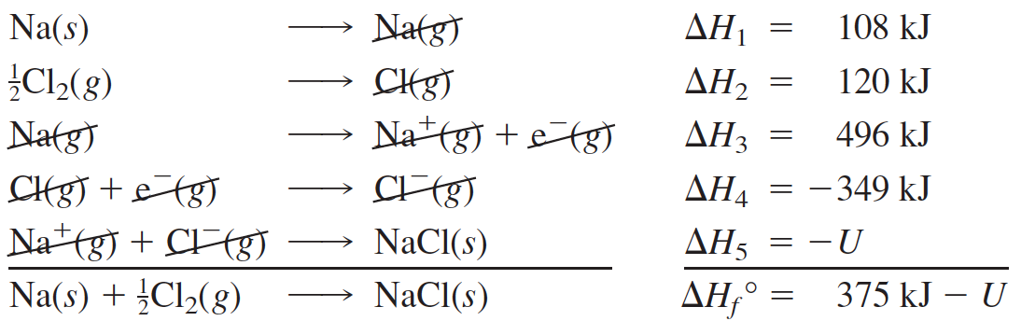
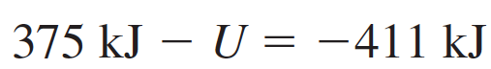
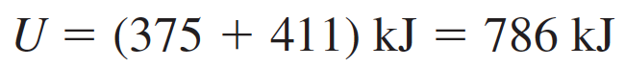
Lattice Energies from the Born–Haber Cycle
Lattice Energy,

Slide 9
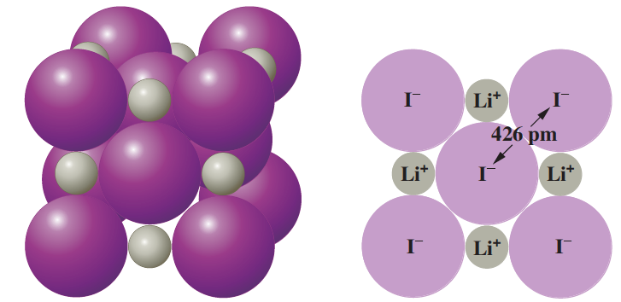
Ionic Radii
The ionic radius is a measure of the size of the spherical region around the nucleus of an ion within which the electrons are most likely to be found.
The distance between iodine nuclei (426 pm) is determined experimentally. One-half of this distance (213 pm) equals the iodide ion radius.

Slide 10
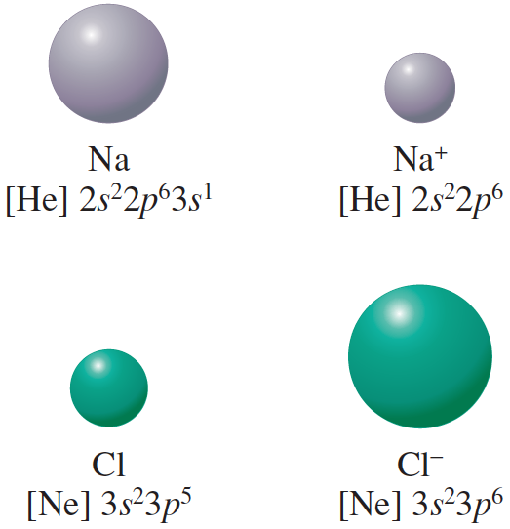
Comparison of atomic and ionic radii
Sodium atom loses its outer
shell in forming the Na⁺ ion. Thus, the cation is smaller than the atom.
The Cl– ion is larger than the Cl atom, because the same nuclear charge holds a greater number of electrons less strongly
Which has the larger radius, S or S^{2–}? Explain.
Which has the larger radius, Mg or Mg²⁺? Explain.

Slide 11
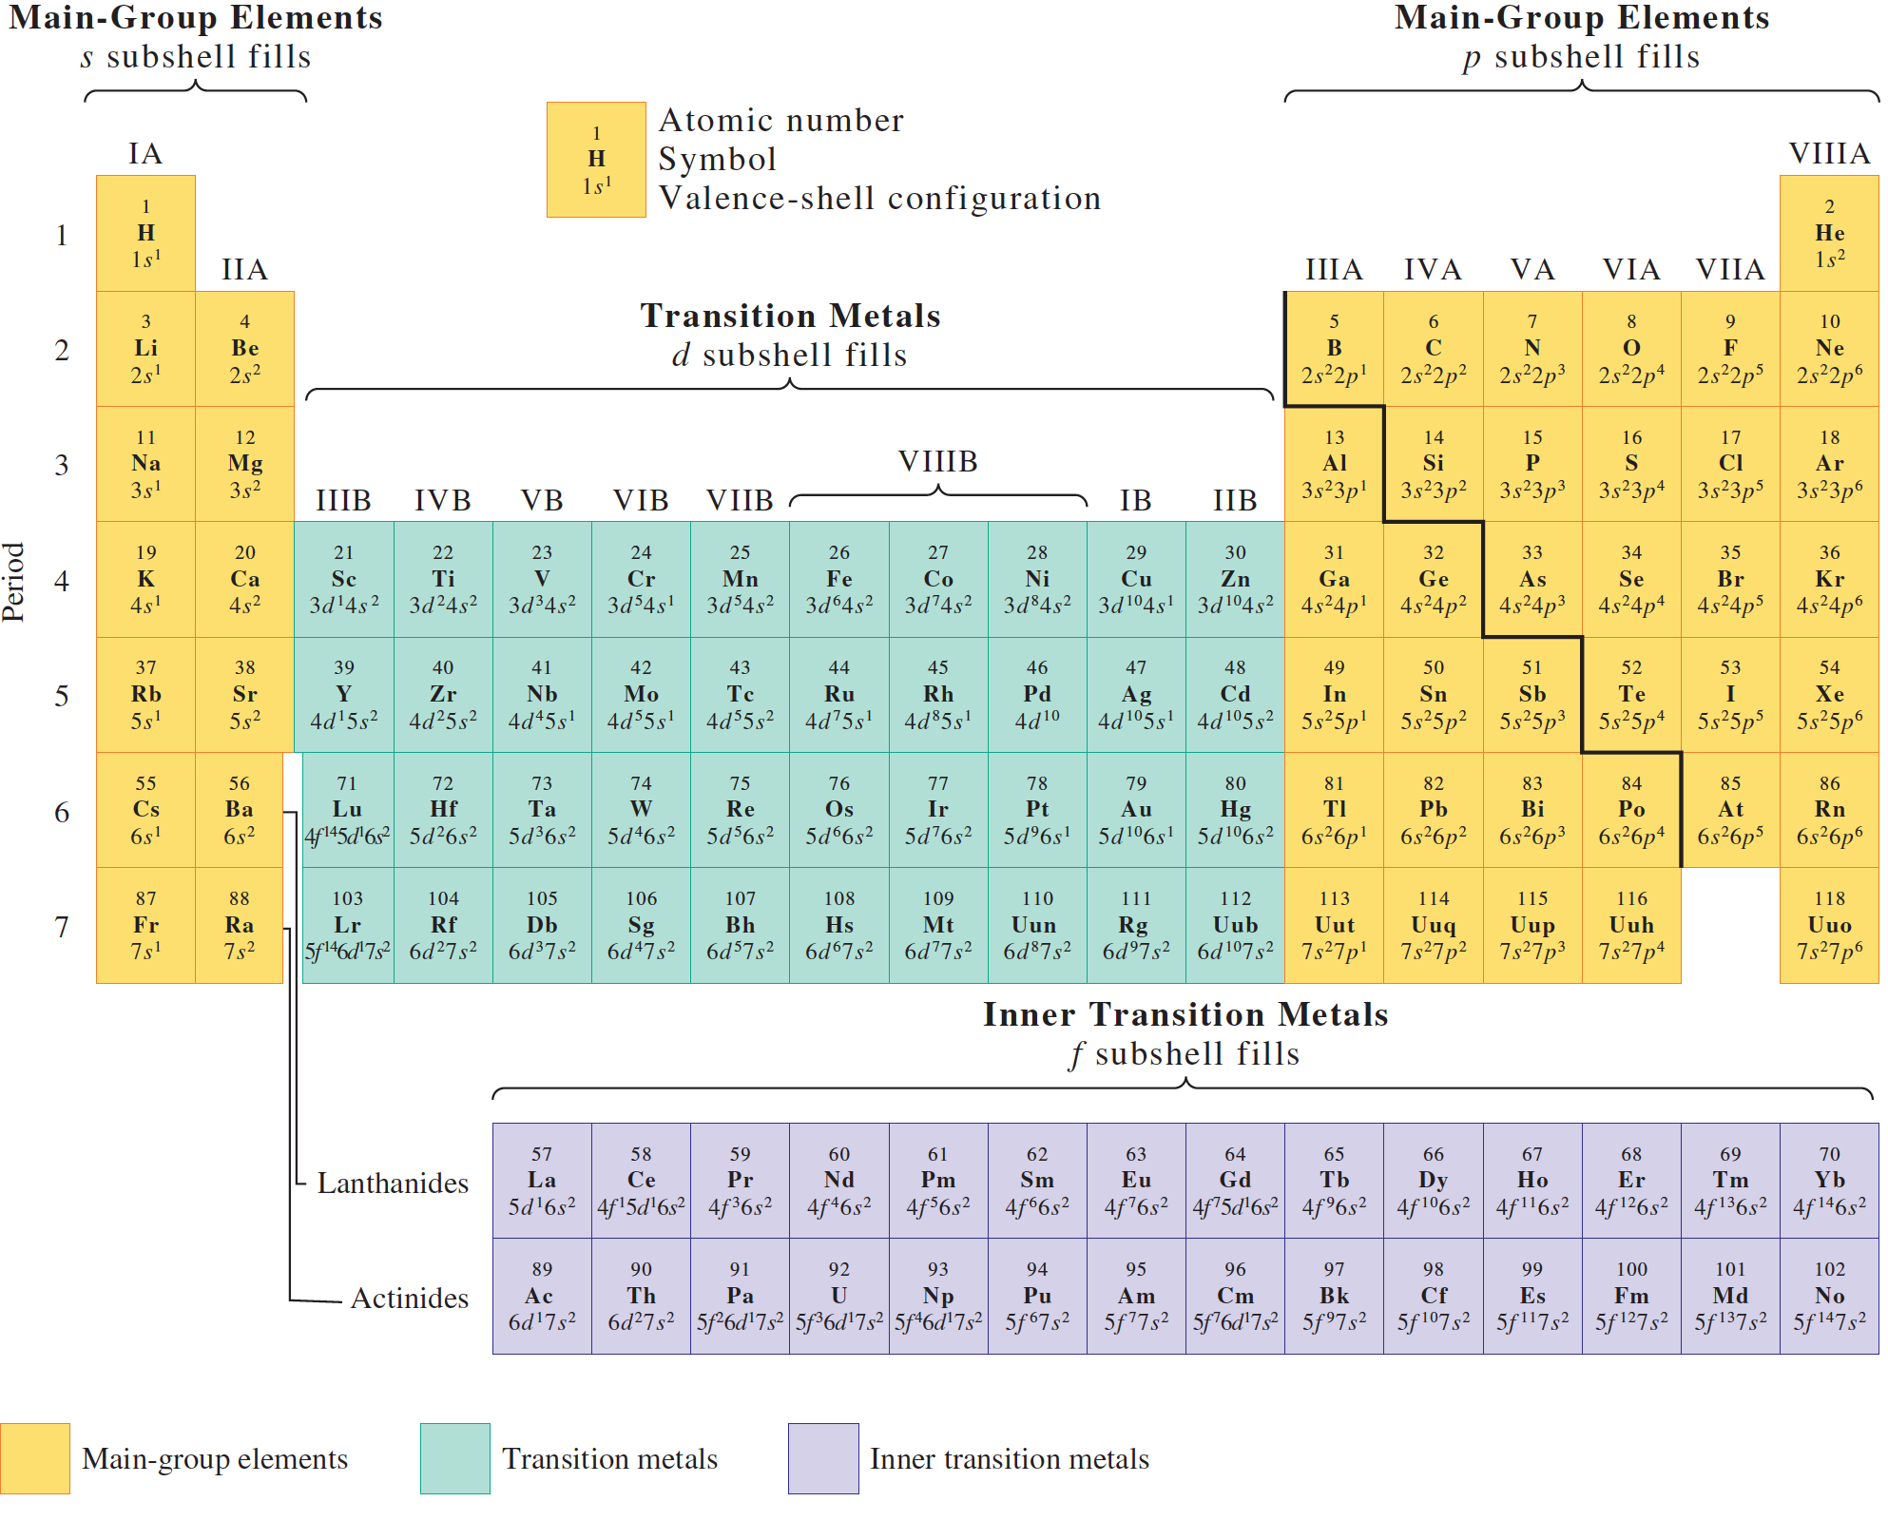
Arrange the following ions in order of increasing ionic radius: Sr²⁺, Mg²⁺, Ca²⁺.

Slide 12
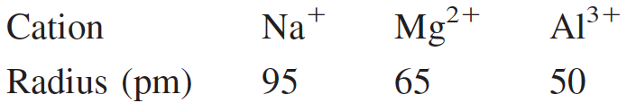
Isoelectronic Species
All of these ions have the neon configuration 1s²2s²2p⁶ but different nuclear charges; that is, they are isoelectronic. Isoelectronic refers to different species having the same number and configuration of electrons.
To understand the decrease in radius from Na⁺ to Al³⁺, imagine the nuclear charge (atomic number) of Na⁺ to increase. With each increase of charge, the orbitals contract due to the greater attractive force of the nucleus. Thus, in any isoelectronic sequence of atomic ions, the ionic radius decreases with increasing atomic number.

Slide 13
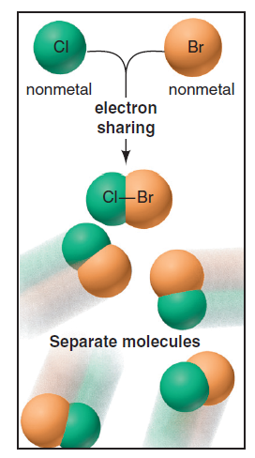
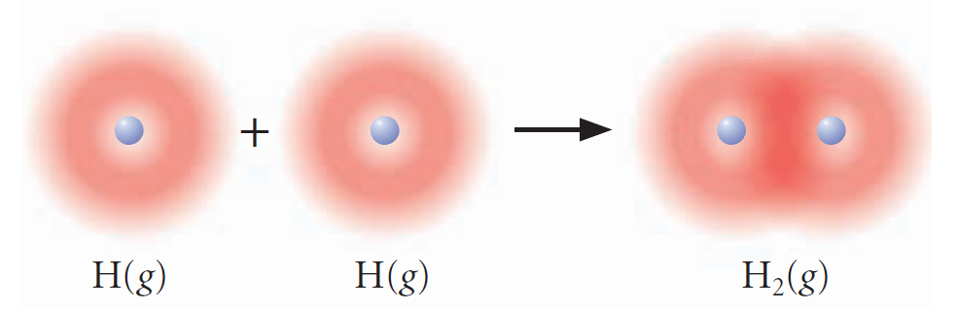
Covalent bonding
Gilbert Lewis
H. + H. → H₂

Slide 14
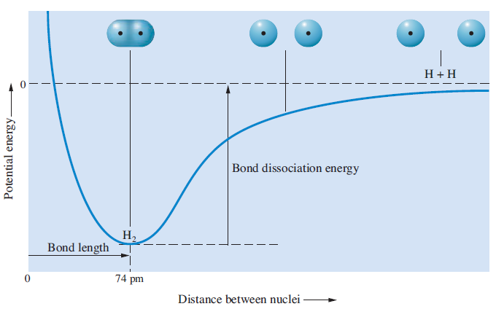
Energy Involved in Covalent bonding

Slide 15
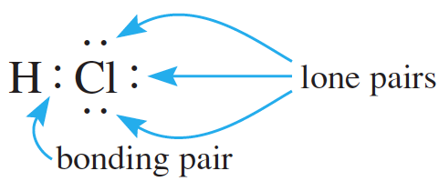
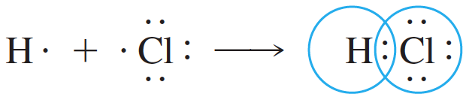
Lewis Formulas
A formula using dots to represent valence electrons is called a Lewis electron-dot formula. An electron pair represented by a pair of dots in such a formula is either a bonding pair (an electron pair shared between two atoms) or a lone, or nonbonding, pair (an electron pair that remains on one atom and is not shared).

Slide 16
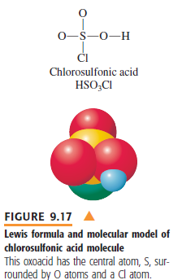
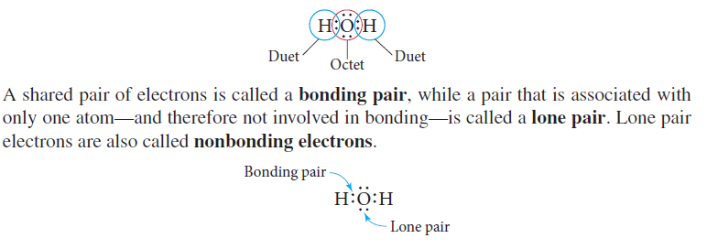
Lewis Electron-Dot Formulas
The octet rule is a chemical rule of thumb that states that atoms tend to combine in such a way that they each have eight electrons in their valence shells, giving them the same electronic configuration as a noble gas. The rule is applicable to the main-group elements
Lewis dot structure: The electron-dot formula is a simple two-dimensional representation
of the positions of electrons in a molecule
Write the skeletal structure of the compound
Count the total number of valence electrons present
Draw a single covalent bond between the central atom and each of the surrounding atoms
Complete the octets of the atoms bonded to the central atom

Slide 17
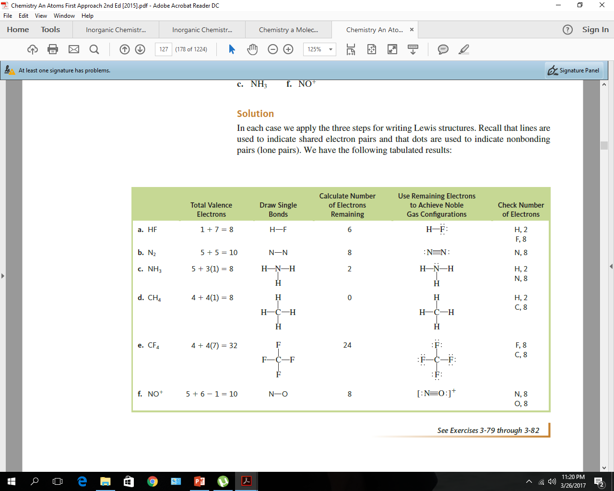
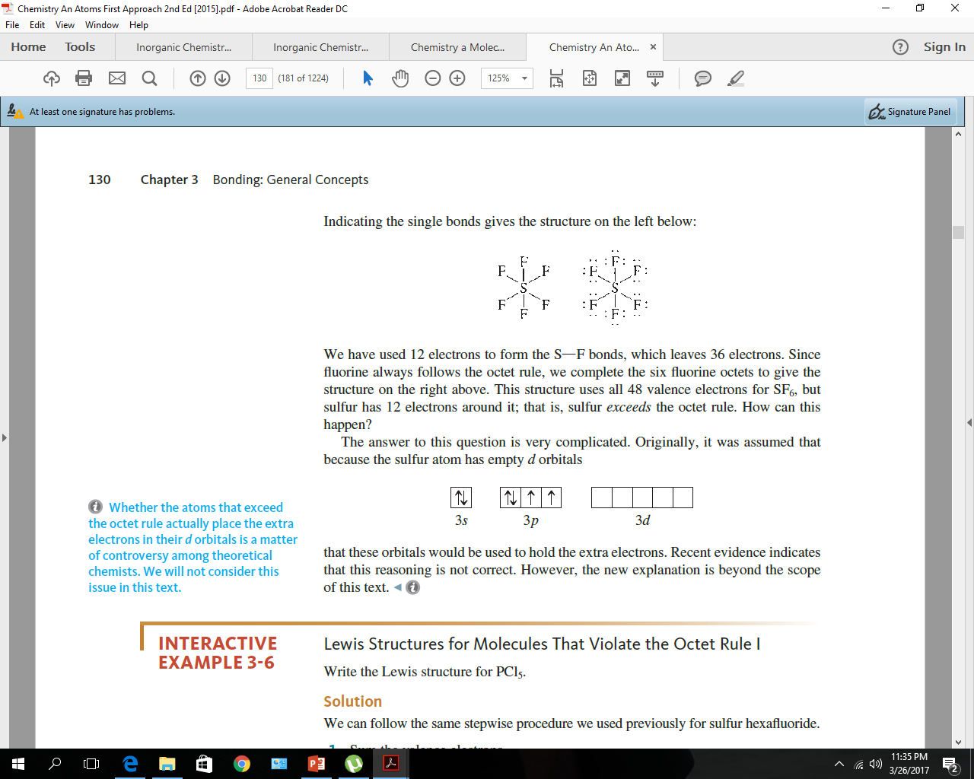
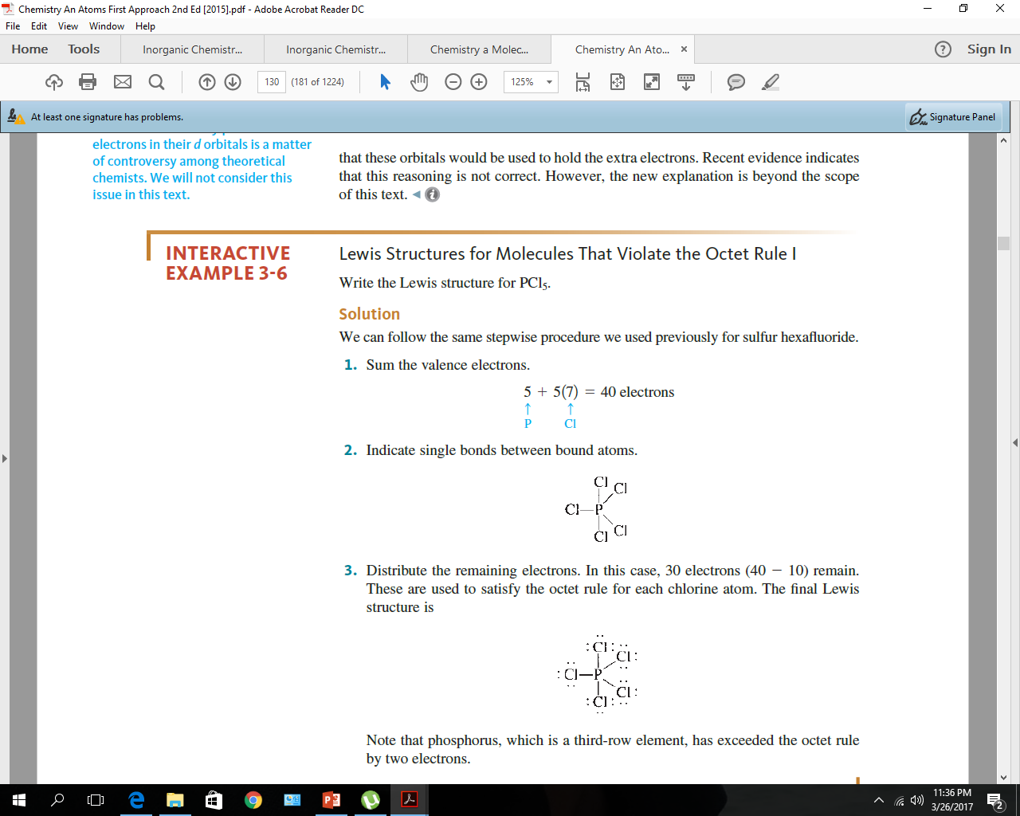

Slide 18
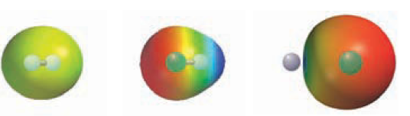
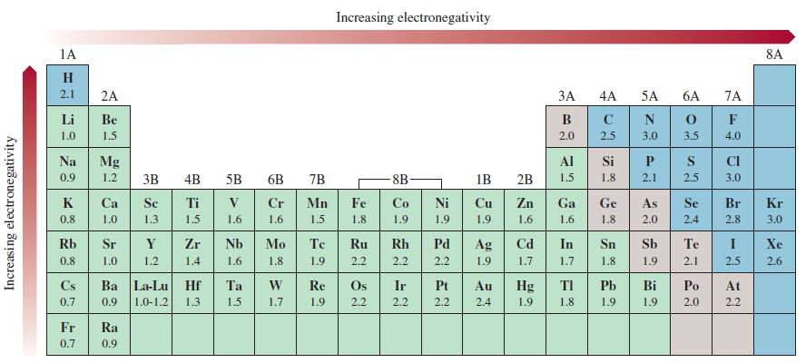
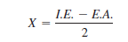
Electronegetivity: the concept of polar covalent bonding
Mullikan
Linus Pauling from bond energies

Slide 19
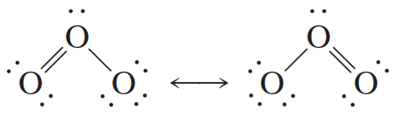
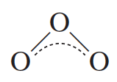
Delocalized Bonding: Resonance
delocalized bonding is a type of bonding in which a bonding pair of electrons is spread over a number of atoms rather than localized between two.
The electron structure of a molecule having delocalized bonding is described by writing all possible electron-dot formulas
We might symbolically describe the delocalized bonding in ozone as follows:

Slide 20
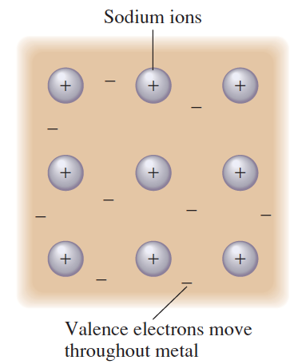
Metals: Extreme Examples of Delocalized Bonding
Metal can be regarded as an array of metal ions surrounded by a “sea” of electrons. The valence, or bonding, electrons are delocalized over the entire metal crystal.
The freedom of these electrons to move throughout the crystal is responsible for the electrical conductivity of a metal.

Slide 21
Bond Length and Bond Order
Bond length (or bond distance) is the distance between the nuclei in a bond. Bond lengths are determined experimentally using x-ray diffraction or the analysis of molecular spectra.
The bond order, defined in terms of the Lewis formula, is the number of pairs of electrons in a bond. For example, in C : C the bond order is 1 (single bond); in C : : C the bond order is 2 (double bond).
Bond length depends on bond order. As the bond order increases, the bond strength increases and the nuclei are pulled inward, decreasing the bond length.
The average C – C bond length is 154 pm, whereas C=C is 134 pm long and CΞC is 120 pm long.

Slide 22
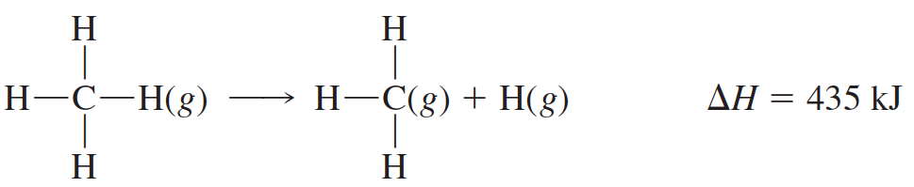
Bond Energy
The bond dissociation energy is a measure of the strength of a particular bond and is essentially the enthalpy change for a gas-phase reaction in which a bond breaks.
We define the A–B bond energy as the average enthalpy change for the breaking of an A–B bond in a molecule in the gas phase. For example, to calculate a value for the C–H bond energy, you might look at the experimentally determined enthalpy change for the breaking of all the C–H bonds in methane:
The average value for breaking one C–H bond is its bond energy
BE(C–H) = 1662/4 kJ = 416 kJ

Slide 23

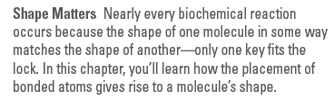
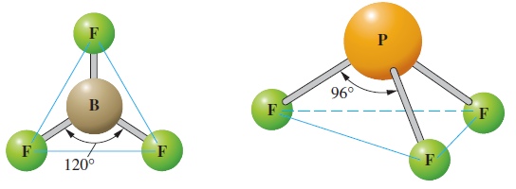
Molecular geometry
Three-dimensional arrangement of the atoms that constitute a molecule
BF₃
PF₃
Planar or flat
B-F 120º
Trigonal planar
Non-planar
B-F 96º
Trigonal pyramidal

Slide 24
Experimental methods for determination of molecular geometry
X-ray diffraction
Electron diffraction
Neutron diffraction
Spectroscopic methods
Valence Shell Electron Pair Repulsion (VSEPR) theory
simple approach, based on Lewis electron-dot structures, the VSEPR method in most cases predicts shapes that compare favorably with those determined experimentally.
valence shell is the outermost electron occupied shell of an atom; it holds the electrons that are usually involved in bonding
Electron pair is referred to the electron pair involved in bonding and nonbonding (lone pair)
The valence-shell electron-pair repulsion (VSEPR) model predicts the shapes of molecules
and ions by assuming that the electron pairs are arranged about each atom so that electron pairs are kept as far away from one another as possible, thus minimizing electron-pair repulsions

Slide 25
How to apply the theory
**As far as electron-pair repulsion is concerned, double bonds and triple bonds can
be treated like single bonds
**If a molecule has two or more resonance structures, we can apply the VSEPR
model to any one of them
Procedure:
Step 1: Write the electron-dot formula from the molecular formula.
Step 2: Determine from the electron-dot formula the number of electron pairs around the central atom, including bonding and nonbonding pairs. (Count a multiple bond as one pair. If resonance occurs, use one resonance formula to determine this number.)
Step 3: Determine the arrangement of these electron pairs about the central atom
Step 4: Obtain the molecular geometry from the directions of the bonding pairs for this arrangement
Molecular formula
AB_{x}E
A is the central element
B is the other element for bonding
X is the valency
E is the no. of nonbonding electron pairs

Slide 26
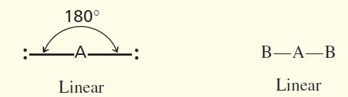
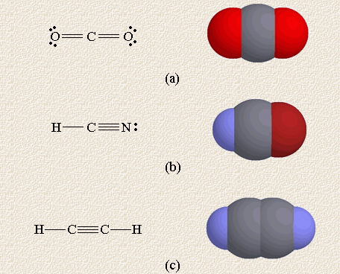
Two electron pair
Molecular type-AB₂
Example: BeCl₂, HgCl₂, BeF₂
Compounds containing double bonds with linear shape

Slide 27
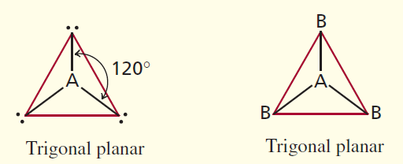
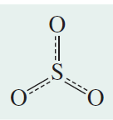
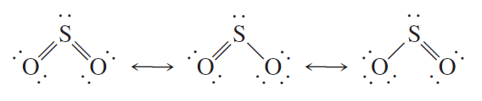
Three electron pair
Molecular type-AB₃
Example: BF₃, NO₃⁻, CO₃²⁻
SO₃
Molecular type-AB₂E
Example: SO₂, O₃, PbCl₂
Bend or angular

Slide 28
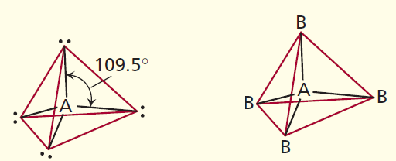
Four electron pair
AB₄, AB₃E, AB₂E₂
Molecular type-AB₄
Formula Bond pair loan pair Geometry Example
AB₄ 4 0 Tetrahedra CH₄, NH₄⁺, SiCl₄, SO₄²⁻, ClO₄⁻
AB₃E 3 1 Trigonal Pyramidal NH₃, PF3, ClO₃–, H₃O⁺
AB₂E₂ 2 2 Bend H₂O, OF₂, SCl₂

Slide 29
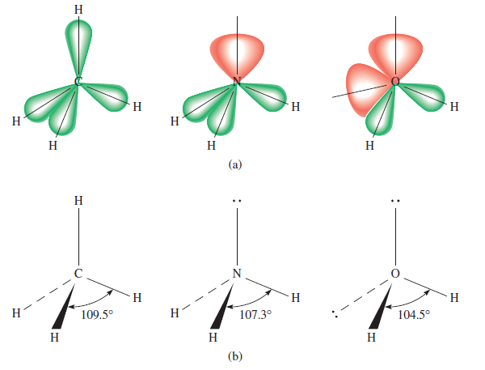
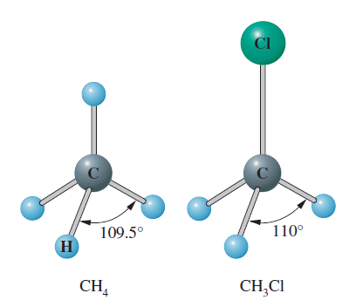
Four electron pair
A lone pair tends to require more space than a corresponding bonding pair

Slide 30
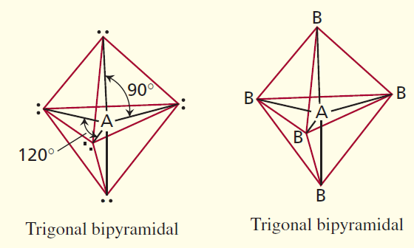
Five electron pair
Formula Bond pair loan pair Geometry Example
AB₅ 5 0 Trigonal bipyramidal PF₅, AsF₅, SOF₄
AB₄E 4 1 Distorted tetrahedron SF₄, XeO₂F₂, lF₄⁺, IO₂F₂–
AB₃E₂ 3 2 T-shape ClF₃, BrF₃
AB2E3 2 3 Linear XeF₂, I₃–, IF₂–

Slide 31
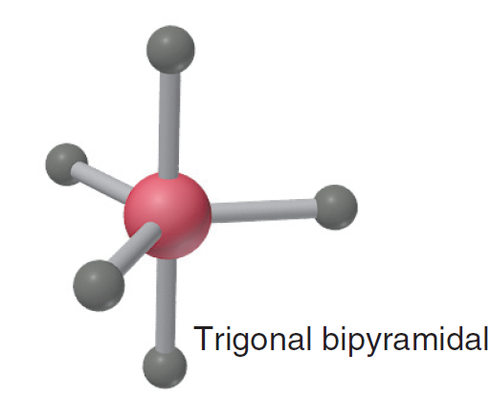
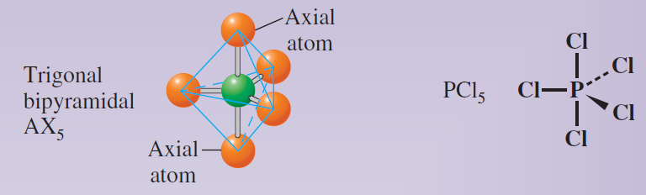
Five electron pair
Three equatorial groups lie in a trigonal plane that includes the central atom, and two axial groups lie above and
below this plane. Therefore, a 120º bond angle separates equatorial groups, and a 90º angle separates axial from equatorial groups.
The greater the bond angle, the weaker the repulsions, so equatorial-equatorial (120º) repulsions are weaker than axial-equatorial (90º) repulsions. The stronger repulsions from lone pairs means that, when possible, lone pairs occupy equatorial positions.
AB₅

Slide 32
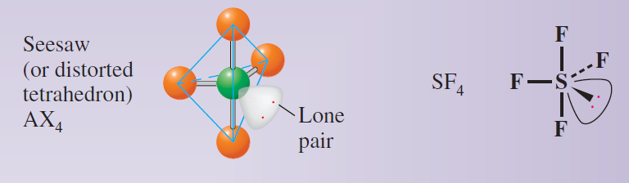
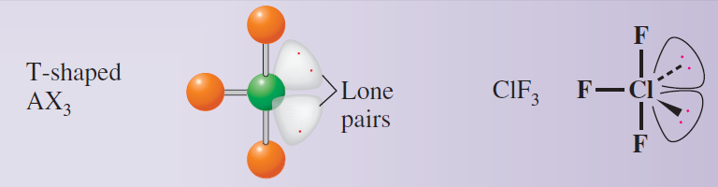
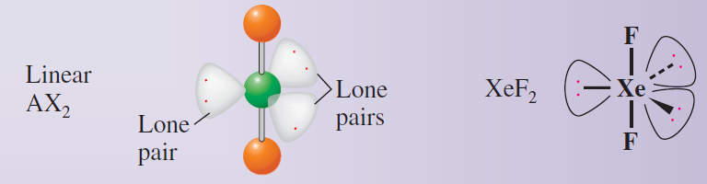
Five electron pair
AB₄E
AB₃E₂
AB₂E₃

Slide 33
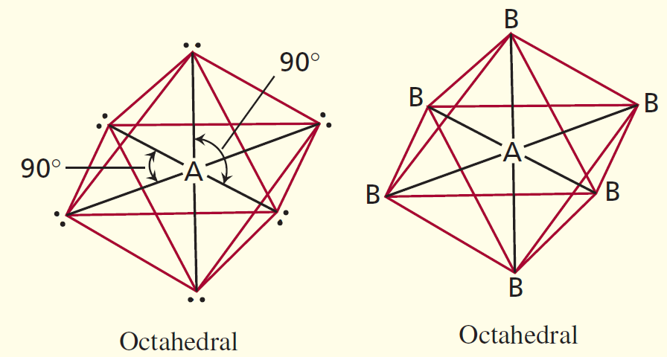
Six electron pair
Formula Bond pair loan pair Geometry Example
AB₆ 6 0 Octahedral SF₆, IOF₅
AB₅E 5 1 Square Pyramidal BrF₅, TeF₅–, XeOF₄
AB₄E₂ 4 2 Square planar XeF₄, ICl₄–

Slide 34
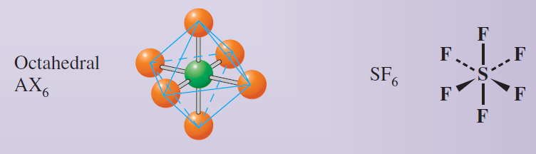
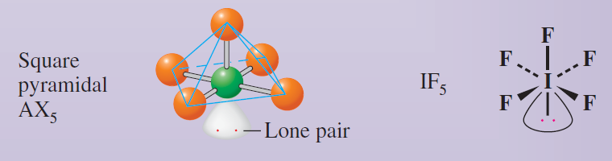
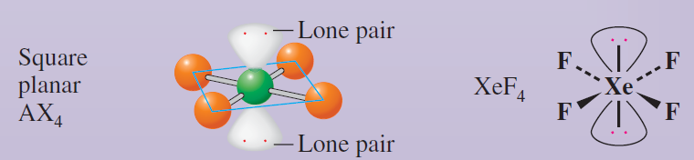
Six electron pair
AB₆
AB₅E
AB₄E₂

Slide 35
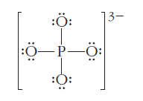
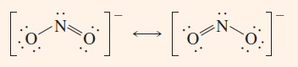
PO₄³⁻
Tetrahedral
NO₂⁻

Slide 36

Dipole Moment and Polarity of Bond
The dipole moment is a quantitative measure of the degree of charge separation in a molecule.
The polarity of a bond, such as that in HCl, is characterized by a separation of electric charge.
A molecule in which the distribution of electric charge is equivalent to charges +δ and –δ separated by a distance d has a dipole moment equal to qδ.
Diplole moments are usually measured in units of debyes (D).
In SI units, dipole moments are measured in coulomb-meters (C.m), and 1 D = 3.34 × 10^{–30} C.m.

Slide 37

Alignment of Polar Molecules by an Electric Field
(A) A polar substance is placed between metal plates.
(B) When the plates are connected to an electric voltage (whose direction is shown by the + and – signs), the polar molecules align so that their negative ends point toward the positive plate.

Slide 38

Attraction of a Polar Liquid to an Electrified Rod
Left: Water is a polar liquid; it is attracted to the electrically charged rod. Charges of signs opposite to
those on the rod form on the liquid surface near the rod, resulting in a net attraction.
Right: Carbon tetrachloride, CCl4, is a nonpolar liquid; it is not attracted to the glass rod.

Slide 39




Relationship Between Molecular Geometry and
Dipole Moment
net dipole moment = zero
net dipole moment = 1.94 D

Slide 40

Relationship Between Molecular Geometry and
Dipole Moment

Slide 41


Dipole Moment and Polarity of Bond
Can you explain why NH₃ has such a large dipole moment compared with NF₃?
Can you explain why cis-1,2-dichloroethane has a large dipole moment, whereas trans-1,2-dichloroethane has zero diploe moment?

Slide 42

Valence Bond Theory
Valence Bond Theory (VBT) is an approximate theory to explain the electron pair or covalent bond by quantum mechanics.
Hybrid orbitals are orbitals used to describe bonding that are obtained by taking combinations of atomic orbitals of the isolated atoms.
Hybrid orbitals can be formed from various numbers of atomic orbitals. The number of hybrid orbitals formed always equals the number of atomic orbitals used.

Slide 43

Spatial Arrangement of sp³
Hybrid Orbitals
(A) The shape of a single sp³ hybrid orbital. Each orbital consists of two lobes. One lobe is small, but dense, and concentrated near the nucleus. The other lobe is large, but diffuse. Bonding occurs with the large lobe, since it extends further from the nucleus. (B) The four hybrid orbitals are arranged tetrahedrally in space. (Small lobes are omitted here for clarity) (C) Bonding in CH₄. Each C–H bond is formed by the overlap of a 1s orbital from a hydrogen atom and an sp³ hybrid orbital of the carbon atom.

Slide 44

Kinds of Hybrid Orbitals

Slide 45

Kinds of Hybrid Orbitals

Slide 46
Applying Valence Bond Theory
Step 1: Write the Lewis electron-dot formula of the molecule.
Step 2: From the Lewis formula, use the VSEPR model to obtain the arrangement of electron pairs about this atom.
Step 3: From the geometric arrangement of the electron pairs, deduce the type of hybrid orbitals on this atom required for the bonding description.
Step 4: Assign valence electrons to the hybrid orbitals of this atom one at a time, pairing them only when necessary.
Step 5: Form bonds to this atom by overlapping singly occupied orbitals of other atoms with the singly occupied hybrid orbitals of this atom.

Slide 47


Applying Valence Bond Theory

Slide 48

Applying Valence Bond Theory

Slide 49


Slide 50


Description of Multiple Bonding
One hybrid orbital is needed for each bond (whether a single or a multiple bond) and for each lone pair.

Slide 51

σ Bond and π Bond
(A) The formation of a σ bond by the overlap of two s orbitals.
(B) A σ bond can also be formed by the overlap of two
p orbitals along their axes.
(C) When two p orbitals overlap sideways, a π
bond is formed.

Slide 52

Bonding in Ethylene
(A) The σ-bond framework in ethylene, formed by the overlap of sp² hybrid orbitals on C atoms and 1s orbitals on H atoms.
(B) The formation of the π bonds in ethylene. When the 2p orbitals are perpendicular to one another, there is no overlap and no bond formation. When the two –CH₂ groups rotate so that the 2p orbitals are parallel, a π bond forms.

Slide 53



